Slide 1
NucE497: Reactor Fuel Performance
Lecture 21: Final Project Assignment
Muhammet Ayanoglu
Mechanical end Nuclear Engineering
February 27, 2017

Slide 2
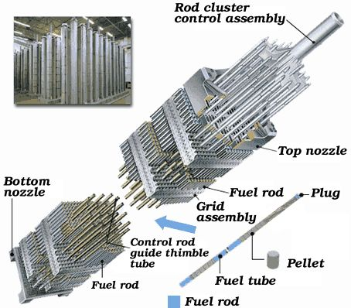
What we discussed so far…
Module-1: Fuel basics
Purpose of the fuel and types of fuel
Fission, heat generation, ﬁssion products
Fuel geometry and the role of cladding
Fuel fabrication
Module-2: Heat transport
Module-3: Mechanical Behavior
Reference: http://www.world-nuclear.org

Slide 3
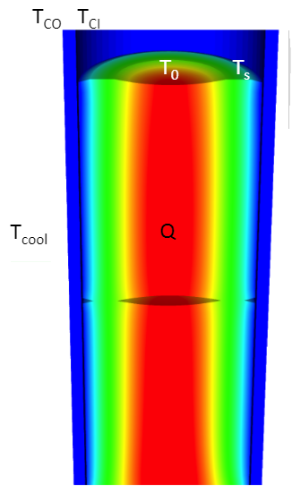
What we discussed so far…
Module-1: Fuel basics
Module-2: Heat transport
Intro to heat transport and the heat equation
Analytical solution of the heat equation
Numerical solution of the heat equation
1D solution of the heat equation using Matlab
2D solution of the heat equation using Matlab
Coolant temperature change, power generation, and melting
Module-3: Mechanical Behavior
NucE497: Nuclear Fuel performance, Lecture 7, Slide 3

Slide 4
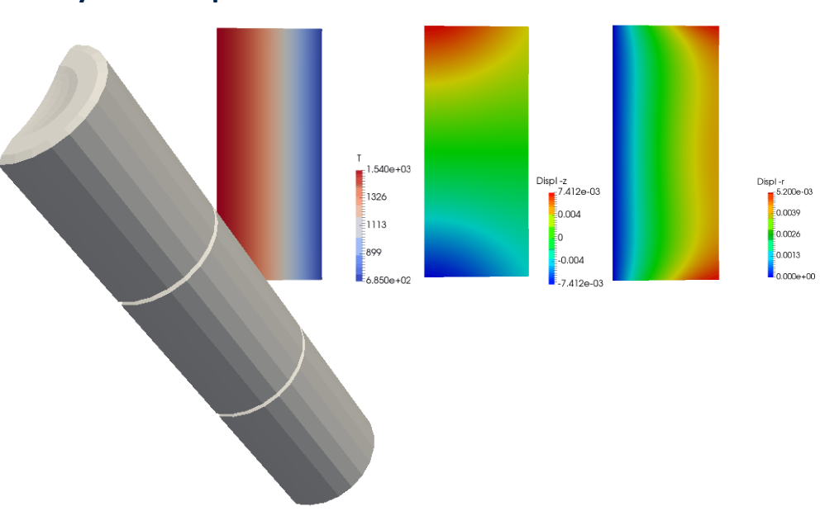
What we discussed so far…
Module-1: Fuel basics
Module-2: Heat transport
Module-3: Mechanical Behavior
Introduction to solid mechanics
Thermomechanics, thermal expansion
Analytical solutions of the mechanics equations
Solving equations in 1D numerically
Solving in multiple dimension with FEM
Summary of fuel performance codes
NucE497: Nuclear Fuel performance, Lecture 16, Slide 18

Slide 5
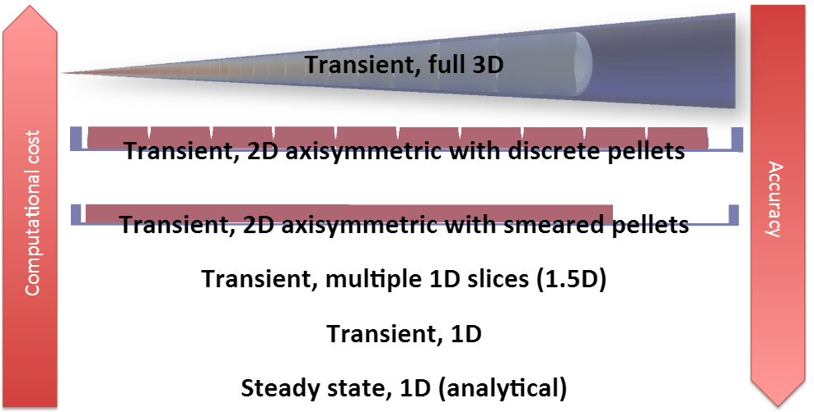
Project goal
The goal of this project is to create a simple fuel performance code and use it to investigate different cases.
1-
MOOSE
2-
MATLAB
3-
You will have the option to create a 1.5D code, a 2D RZ code with smeared pellets, or a 2D RZ code with discrete pellets.

Slide 6
General Description of the Project
10
You will model a fuel rodlet with ten UO2 pellets and surrounded by a zircaloy cladding:
9
Pellet and Clad geometry:
8
COOLANT
7
CLAD
tclad = 0.57 mm
tgap = 80 µm
GAP
6
Rf=4.1 mm
ho=11.9 mm
FUEL
5
4
3
2
1

Slide 7
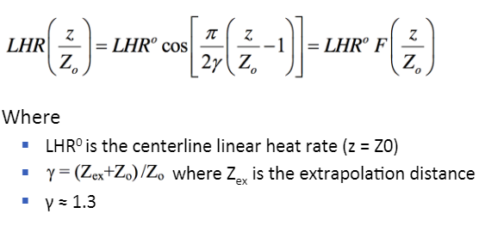
General Description of the Project
Operating conditions:
The power will linearly increase for 3 hrs before reaching its maximum value, resulting from a fission rate of 2.75×10¹³ neutron/cm²s. Power will hold there for 2 years.
The linear heat rate will vary axially according to the equation:

Slide 8
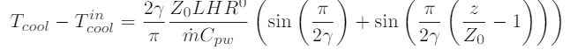
General Description of the Project
Operating conditions:
T_{cool,in} = 580 K,
ṁ = 0.25 kg/s
Cpw= 4200 J/kgK
The coolant temperature along the length of the rodlet using the equation from slide 18 of lecture 7:

Slide 9
General Description of the Project
You will investigate three different cases:
Case A: Fuel, clad and gap properties are burnup independent
Case B: Fuel, clad and gap properties are burnup dependent
Case C: Simulation of loss of coolant accident

Slide 10
General Description of the Project
10
9
Case A: Fuel, clad and gap properties are burnup independent
8
Assumptions
Properties of the fuel, cladding and gap are independent of burnup,
Thermal conductivity should change with temperature,
You should consider the impact of thermal expansion on the gap size.
7
Stop once your result reaches steady-state. Choose a reasonable constant time step size.
6
5
Output:
Plot T vs. radius for the bottom pellet and the 5th pellet from the bottom of the same plot.
Compare against the analytical solution to make sure your solution makes sense.
Turn in your data file!
4
3
2
1

Slide 11
General Description of the Project
Case B: Fuel, clad and gap properties are burnup dependent
Assumptions
Properties of the fuel, cladding and gap are burnup dependent:
Swelling
Fission gas release
Burnup dependent thermal conductivity.
Choose a time step size that gives your reasonable results without taking too long!
Instructions on how to incorporate these will be given in class as we learn about them!
Output:
Run your simulation for 2 years and
Plot To and Ts vs. time on the same plot for bottom pellet and the 5th pellet from the bottom pellet.
Also indicate on your plot at what time these two pellets came in contact with the cladding.
Turn your data files with these three quantities as a function of time.

Slide 12
General Description of the Project
Case C: Simulation of LOCA
Simulate a loss of coolant accident with your code after 2 years of steady operation modeled in Part 2.
Output
If the coolant flow rate drops to 1×10⁻³ kg/s, will the fuel melt?
How low must the coolant flow rate go for the fuel to melt after 6 hours?
Turn in an image file showing the temperature profile throughout the fuel pellet when it reaches the melting temperature after six hours.

Slide 13
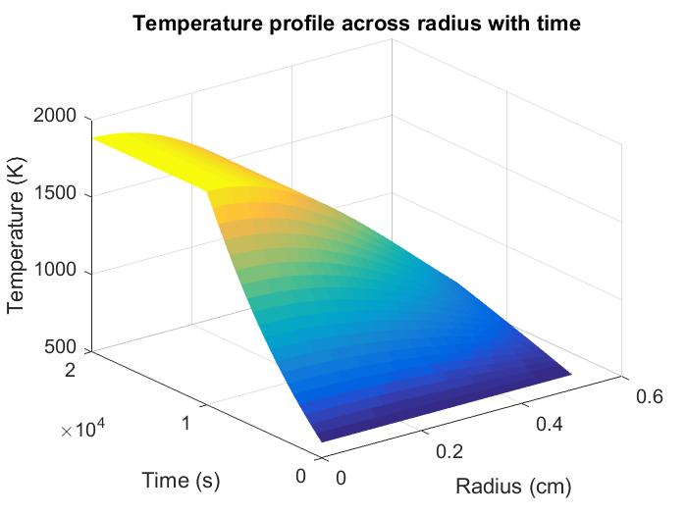
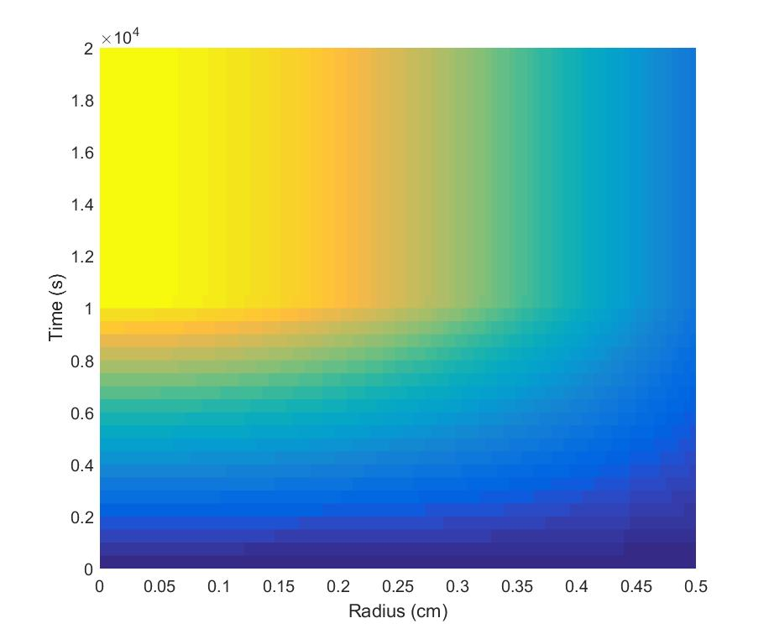
Specific Requirements for the approaches
1.5D in Matlab:
surf
View(2)
The details of your simulation are:
20 elements across the radius
10 different axial locations, with different values for LHR and Tcool, as defined above.
Use the iterative method from the homework to include the closing of the gap. Use the analytical method to determine the centerline temperature for the iterations.
To plot the temperature profile across the gap, create a 20 by 10 matrix with all the temperatures from all the axial slices. Plot it with the surf function and view(2) to make it a 2D shaded plot.

Slide 14
Specific Requirements for the approaches
2D in Matlab:
The details of your simulation are:
Use a max element size of 1/10 the radius
Use the iterative method from the homework to include the closing of the gap.
Use the analytical method to determine the centerline temperature for the iterations.

Slide 15
Specific Requirements for the approaches
2D Discrete Pellets in MOOSE:
Additional directions are provided with the files. Follow them. Do this as soon as possible to make sure you can get the code up and running.
Three meshes are provided that are all interchangeable in the code.
One is for smeared pellets, one for discrete pellets but a coarse mesh, and one for discrete pellets with a fine mesh.
Your final results should use the discrete fine mesh, if possible. If not, you may be allowed to use the discrete coarse mesh (talk to Dr. Tonks).
You will output your temperature profiles using VectorPostProcessors, as done in the example file. You will then need to plot the files in Matlab, Excel, or something similar.
Make images of your solution using Paraview (makes the best images) or Peacock.

Slide 16
Deliverables
Indicate your choice of creating a 1.5D, 2D smeared pellet, or 2D discrete pellet code
A report presenting your results and summarizing your approach
Several data files from your simulations (outlined above)
One image file from your results for part 3 (more detail given above)

Slide 17
Requirements for the Final Report
Formatting requirements:
No more than 4 pages
11 point font
1 inch margins on all sides
To be turned in as a PDF file (you can use any program to write the report)
Section requirements:
You must have the following sections:
Abstract
Introduction
Case 1
Case 2
Case 3
Conclusions
You may have the following sections (they don't count towards the four pages):
References
Appendix

